Slide 1
Visualizing data
Sean McMinn
Digital frameworks
Northwestern University – Summer 2018
Github.com/shmcminn/digitalframeworks-summer18

Slide 2
Data stories?

Slide 3
Steps to a data story
Find data
Clean data
Analyze data
Present data

Slide 4
Agenda
What is good data viz
How to make data viz suck less
When to use different chart types
Quartz Chartbuilder
Mapping tool

Slide 5
Favorite data viz examples

Slide 6
Favorite data viz examples
https://archive.nytimes.com/www.nytimes.com/interactive/2009/11/06/business/economy/unemployment-lines.html?hp
https://www.washingtonpost.com/graphics/national/mapping-the-2017-eclipse/?utm_term=.58658a0b34c2
https://xkcd.com/1732/

Slide 7
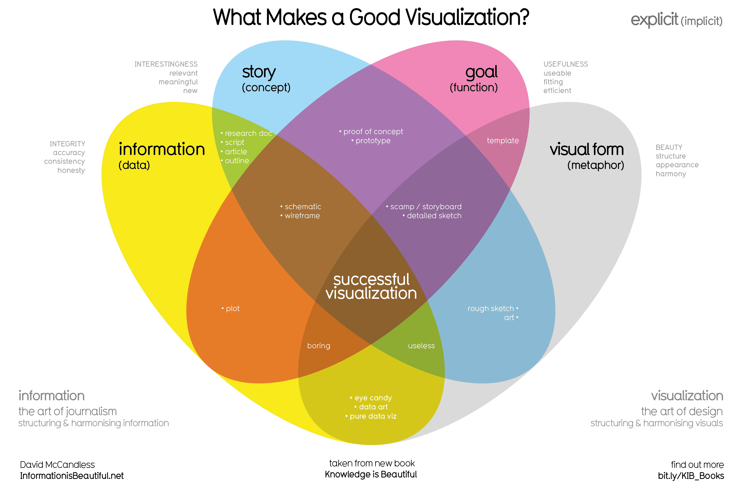

Slide 8
What Makes a Good Viz?
Reliable data
We’ve covered this extensively, but it becomes even more important in data viz
People trust charts – don’t lie with them.
More on this later

Slide 9
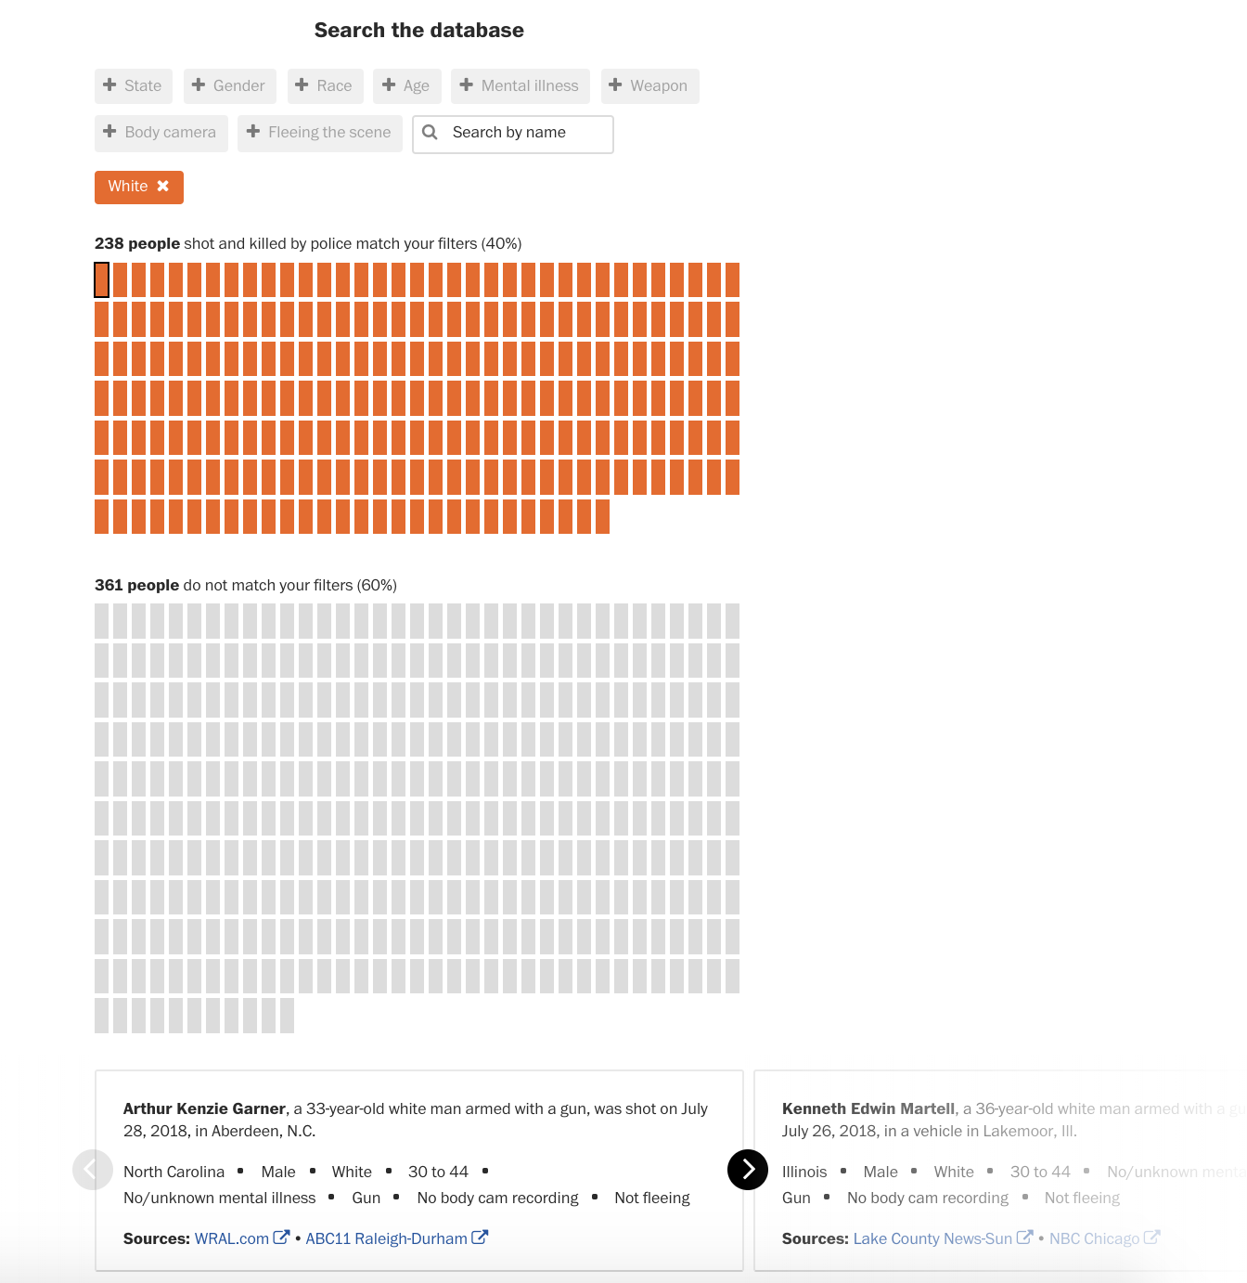
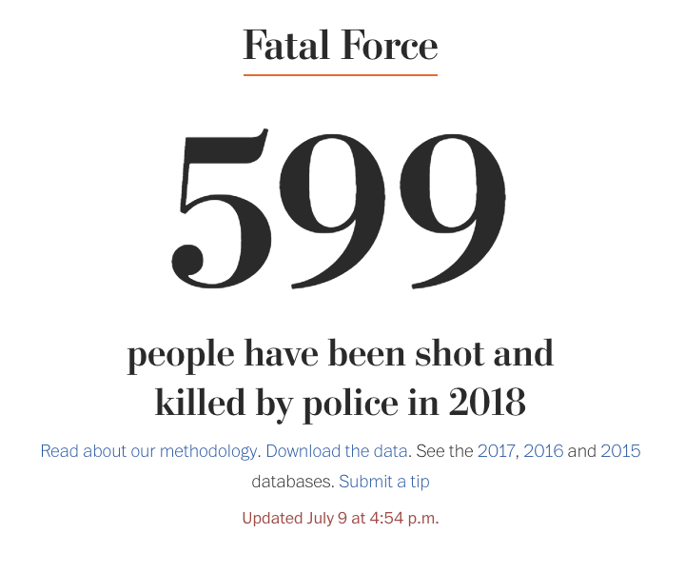
What Makes a Good Viz?
Tell a story
Find meaning

Slide 10
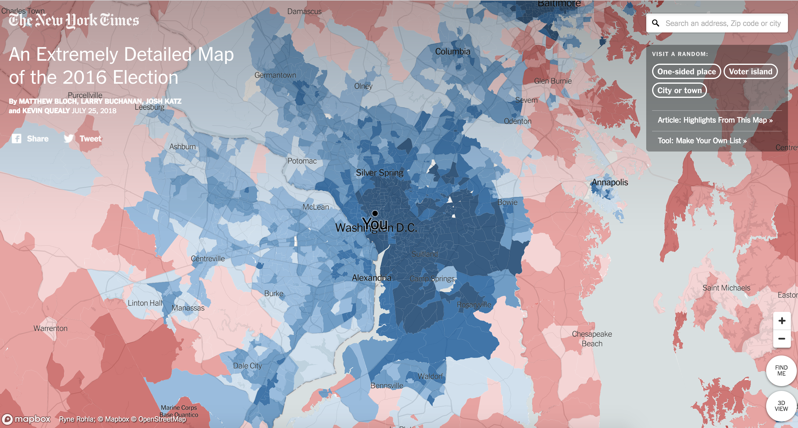
What Makes a Good Viz?
Have a goal – be useful to your reader

Slide 11
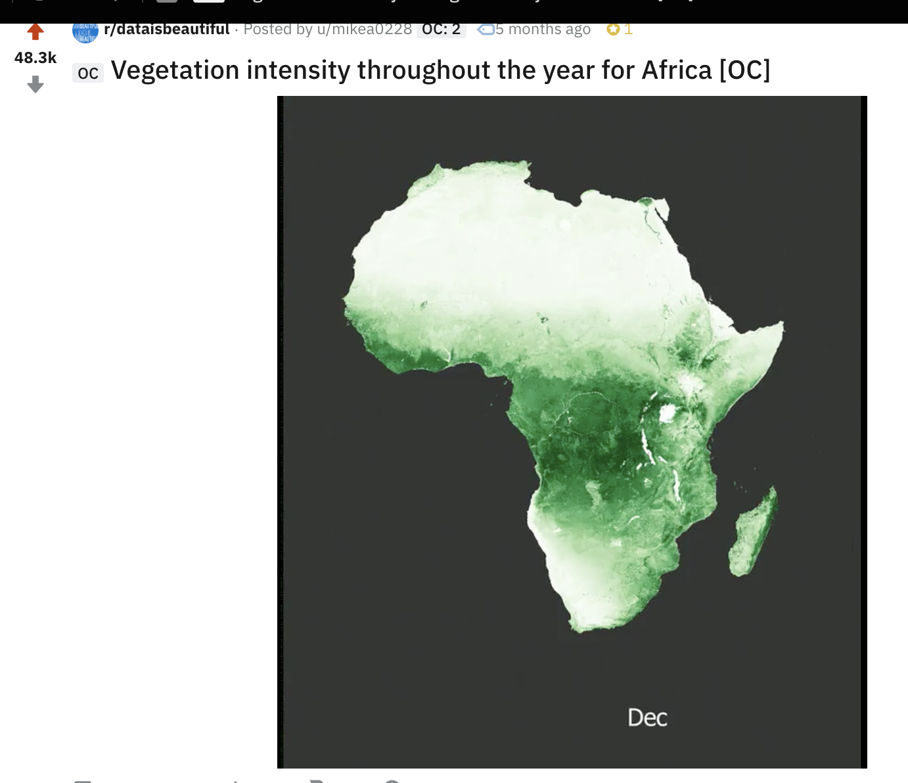
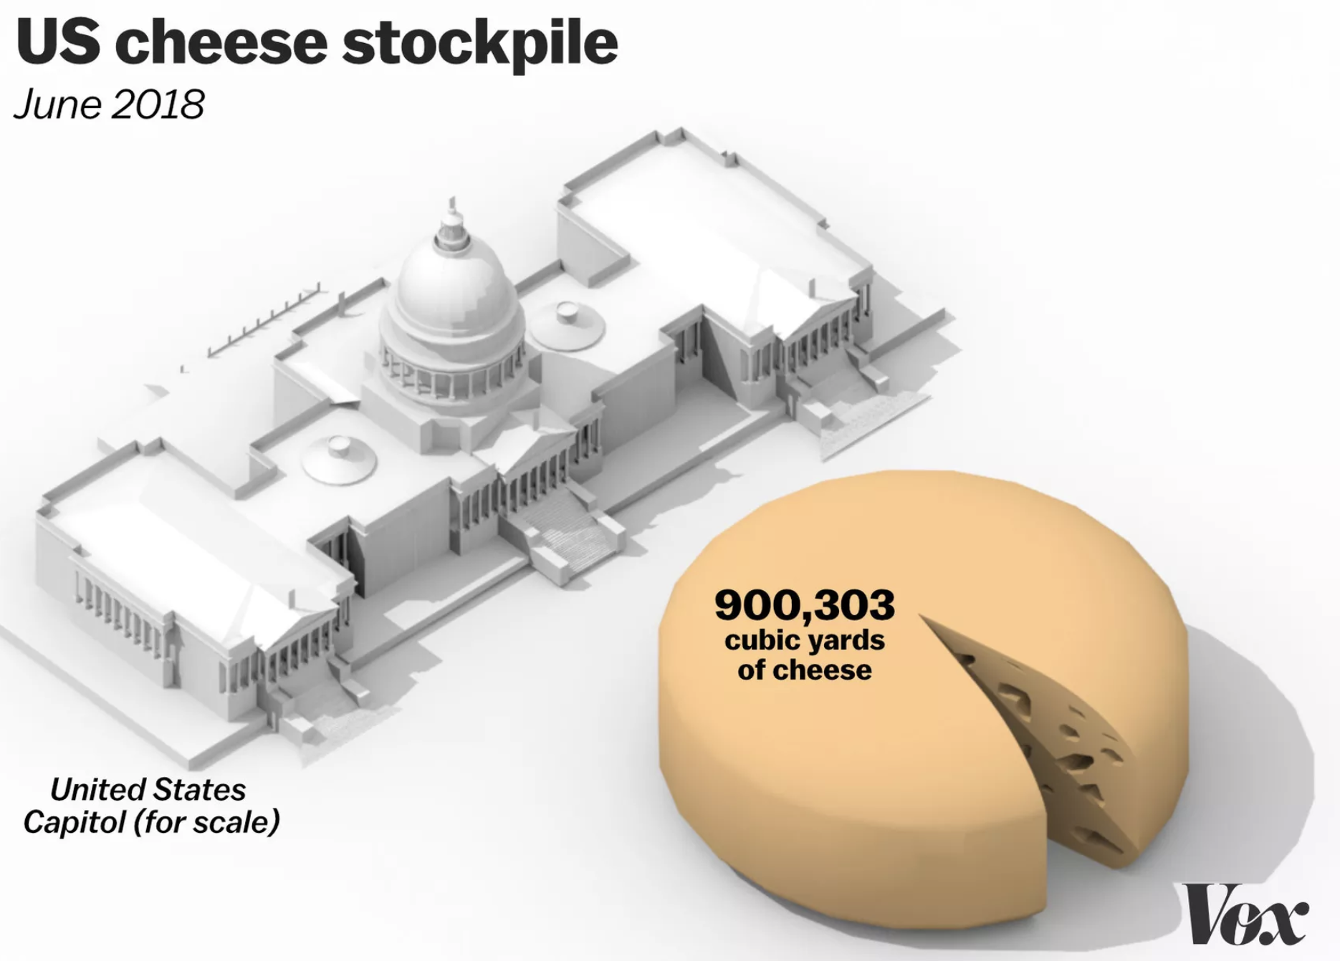
What Makes a Good Viz?
Be beautiful

Slide 12
Unfortunately ….
There are a lot of Bad Charts out there
In fact, there’s a whole Tumblr blog full of them http://viz.wtf/
Here are a few …

Slide 13
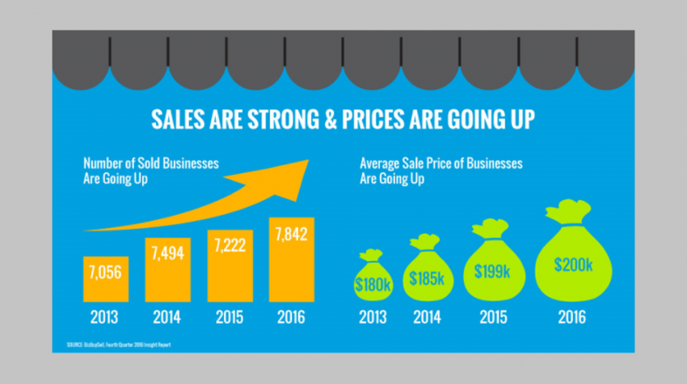
Unfortunately ….

Slide 14
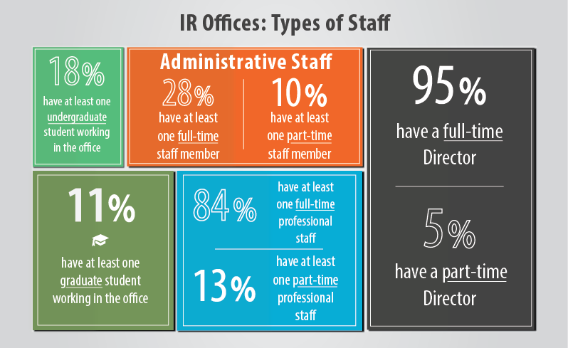
Unfortunately ….

Slide 15
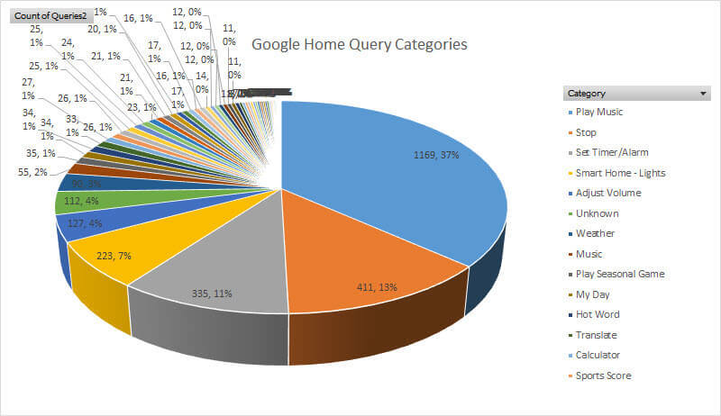
Unfortunately ….

Slide 16
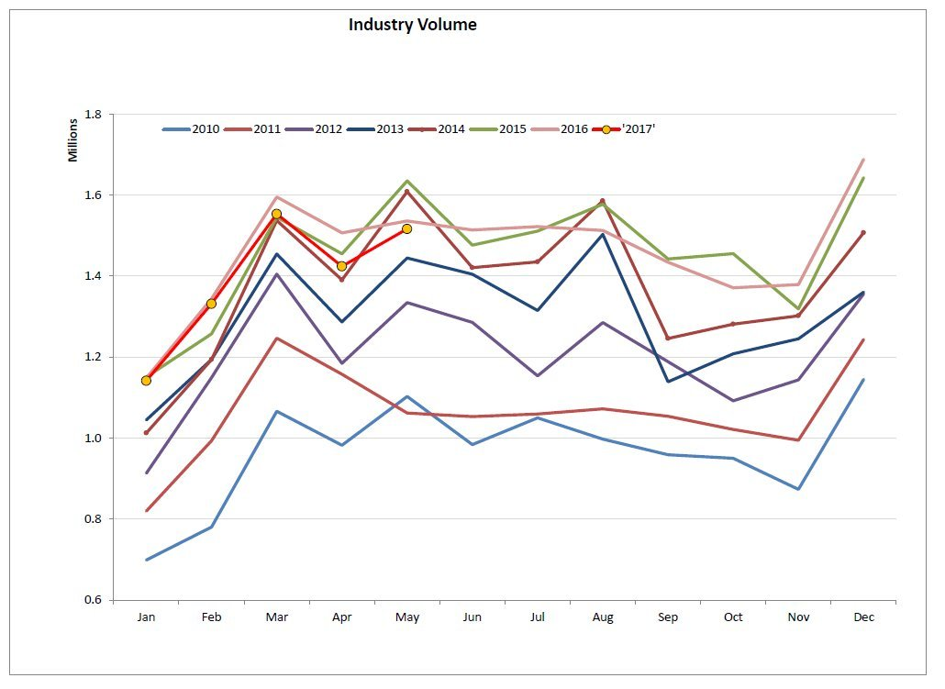
Unfortunately ….

Slide 17
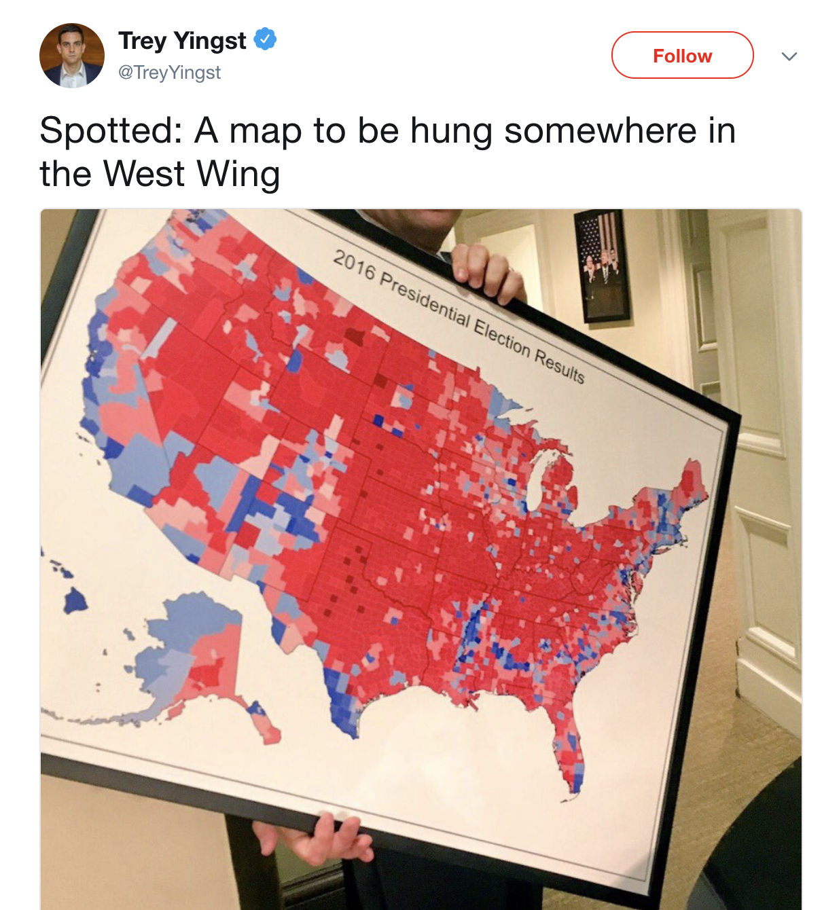
Unfortunately ….
And one of my favorites

Slide 18

Unfortunately ….
And it’s not just my favorite – people love this map

Slide 19

Unfortunately ….
But it’s a lie

Slide 20
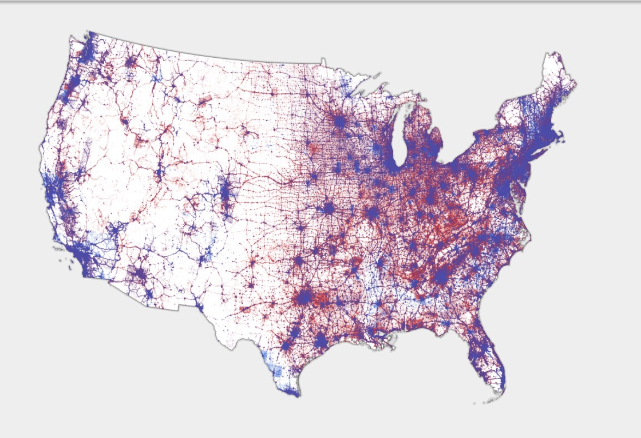
Distributed votes by population
https://www.wired.com/story/is-us-leaning-red-or-blue-election-maps/amp

Slide 21
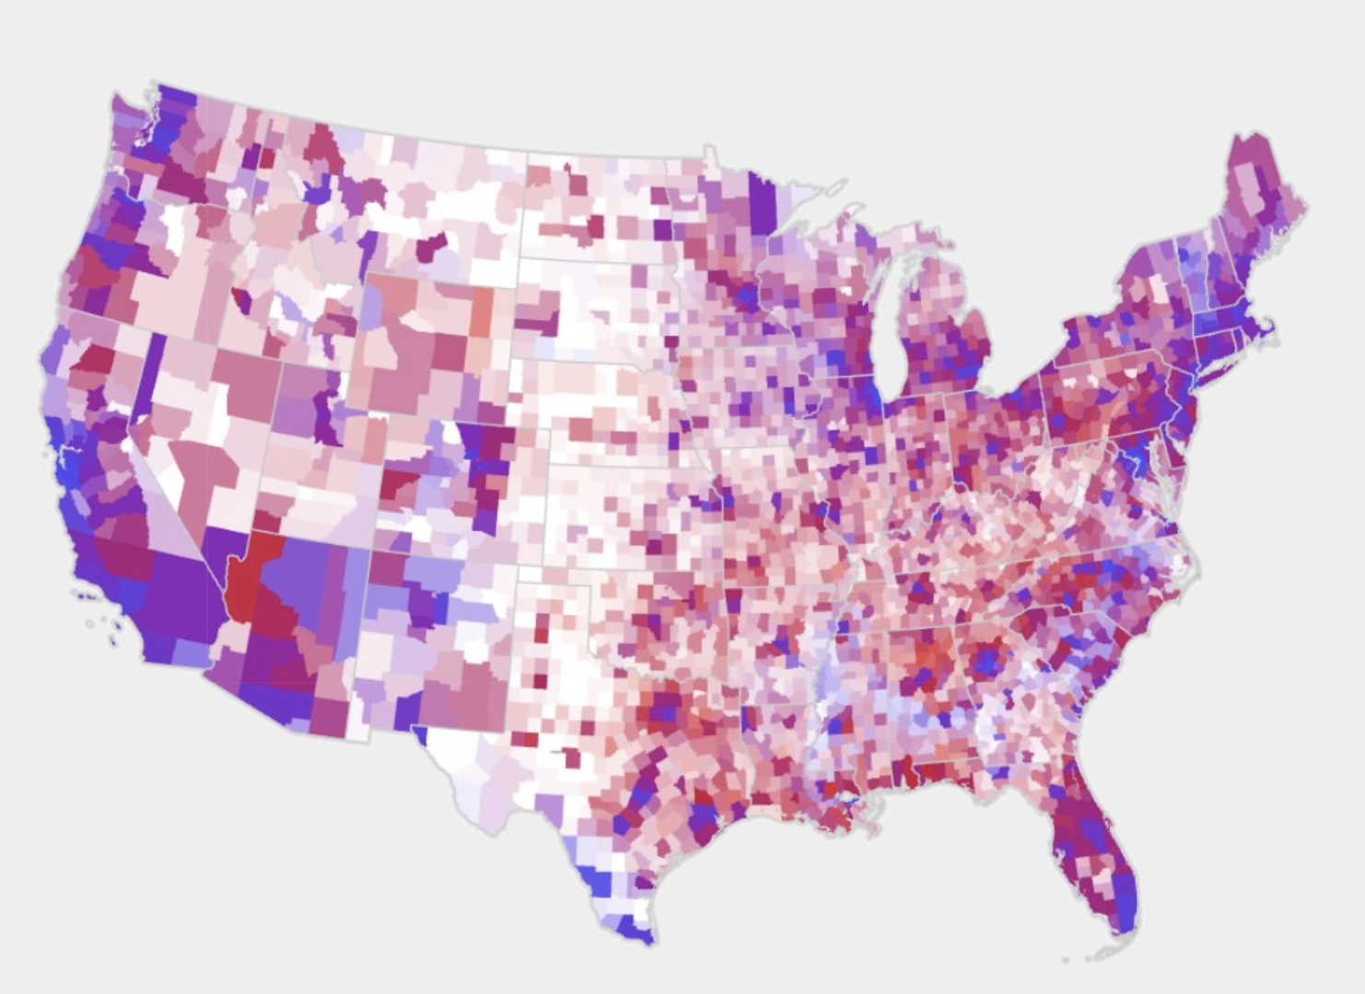
Difference in votes, with pop.
https://www.wired.com/story/is-us-leaning-red-or-blue-election-maps/amp

Slide 22
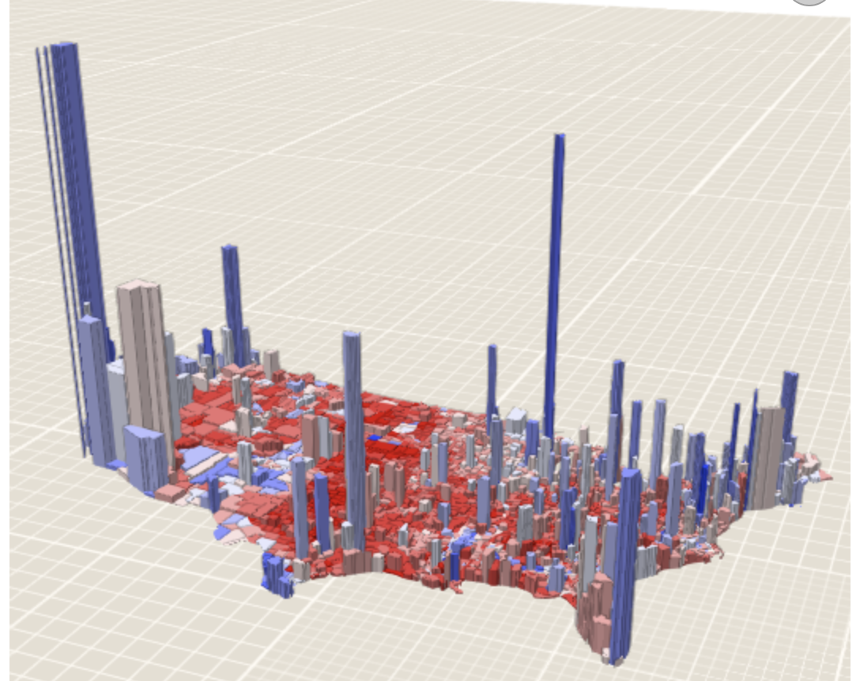
3D population vs. winner
https://www.wired.com/story/is-us-leaning-red-or-blue-election-maps/amp

Slide 23
So what’s a chartmaker to do?
Data: Make sure readers can accurately understand the data in the form you present it in
Story: Choose an interesting angle of the data to visualize
Function: Think about why/how your visualization would be useful to your readers, and ensure it does that
Design: Keep it simple, stupid.

Slide 24

My critiques of Congress’ charts

Slide 25
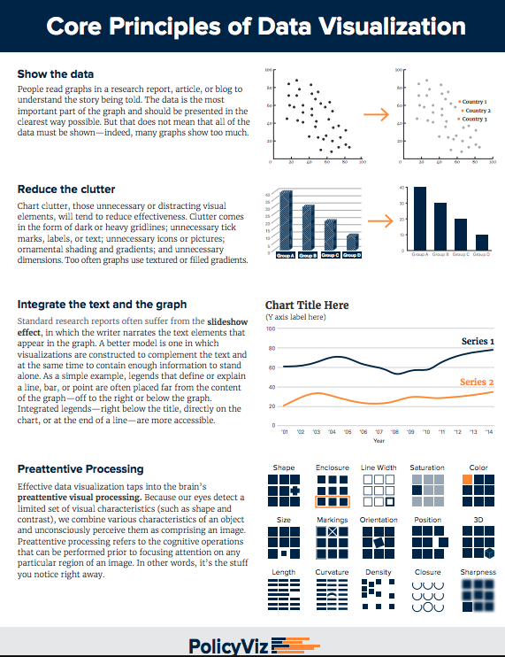
More Tips
http://policyviz.com/wp-content/uploads/2018/08/PolicyViz-DataViz-Cheatsheet.pdf

Slide 26
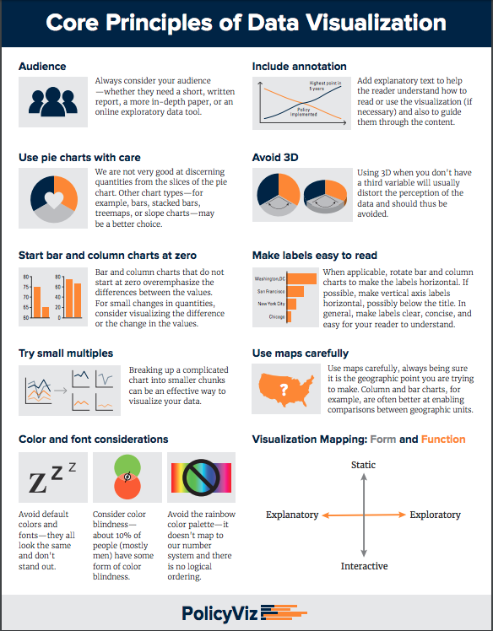
More Tips
http://policyviz.com/wp-content/uploads/2018/08/PolicyViz-DataViz-Cheatsheet.pdf

Slide 27
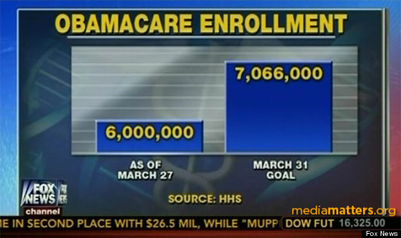

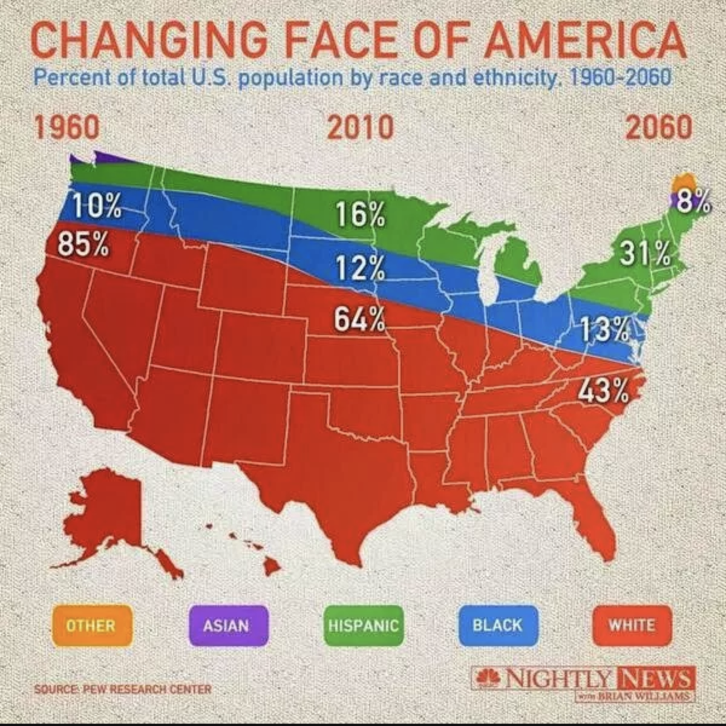
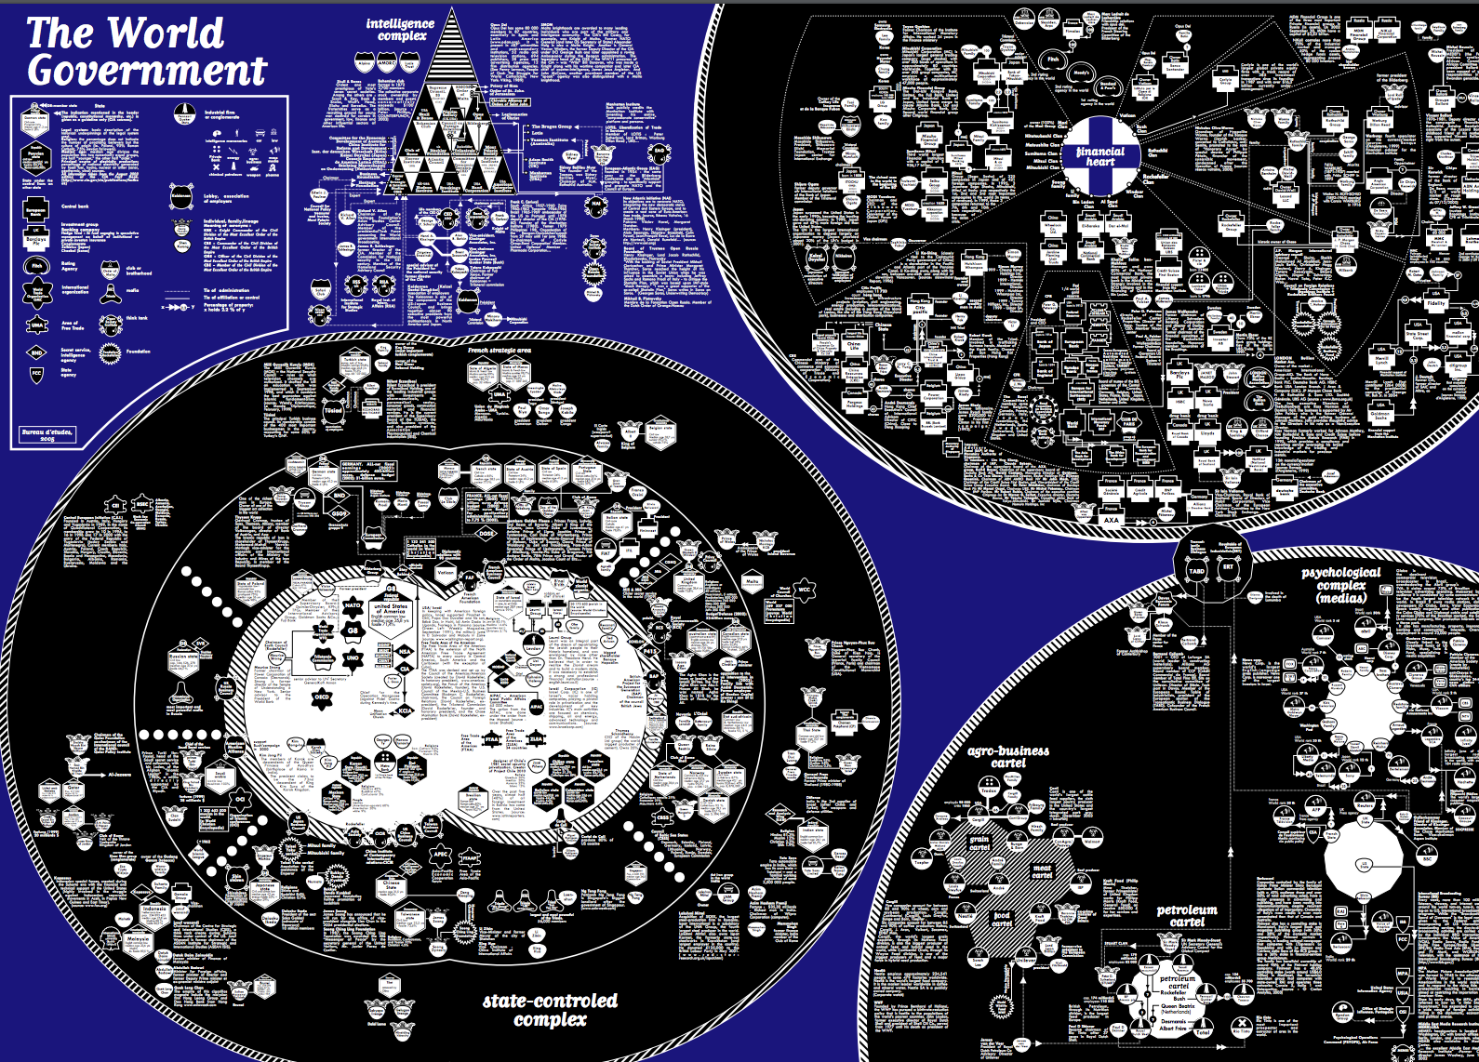
In pairs, critique one of these
Fox News Obamacare
CBC parliament chart
The World Government
NBC U.S. race viz

Slide 28
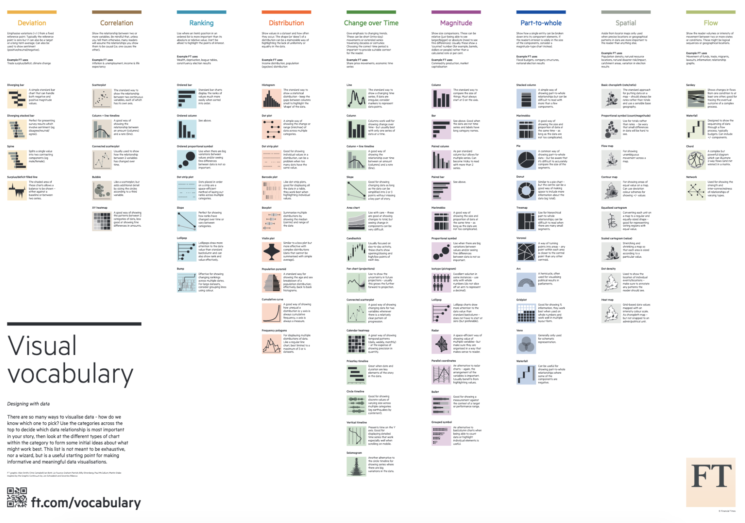
When to Use Different Charts
Easiest answer: print this out
https://github.com/ft-interactive/chart-doctor/blob/master/visual-vocabulary/Visual-vocabulary.pdf

Slide 29
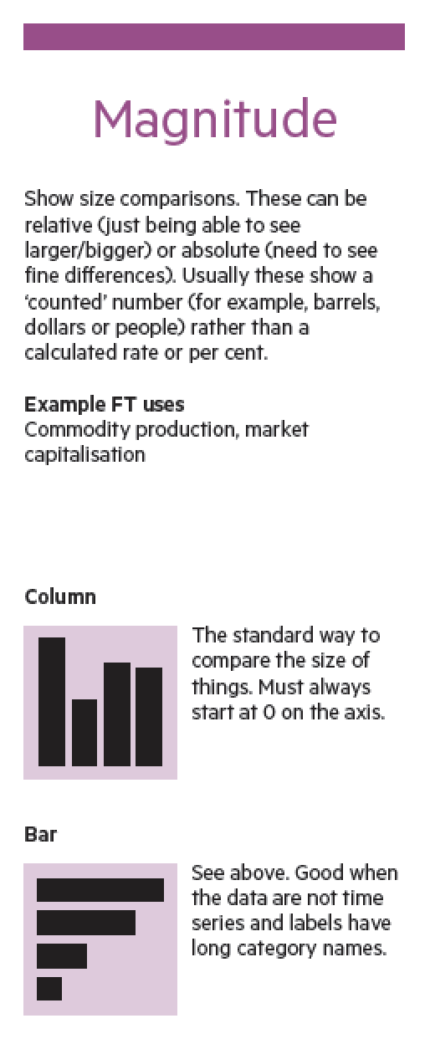
When to Use Different Charts

Slide 30
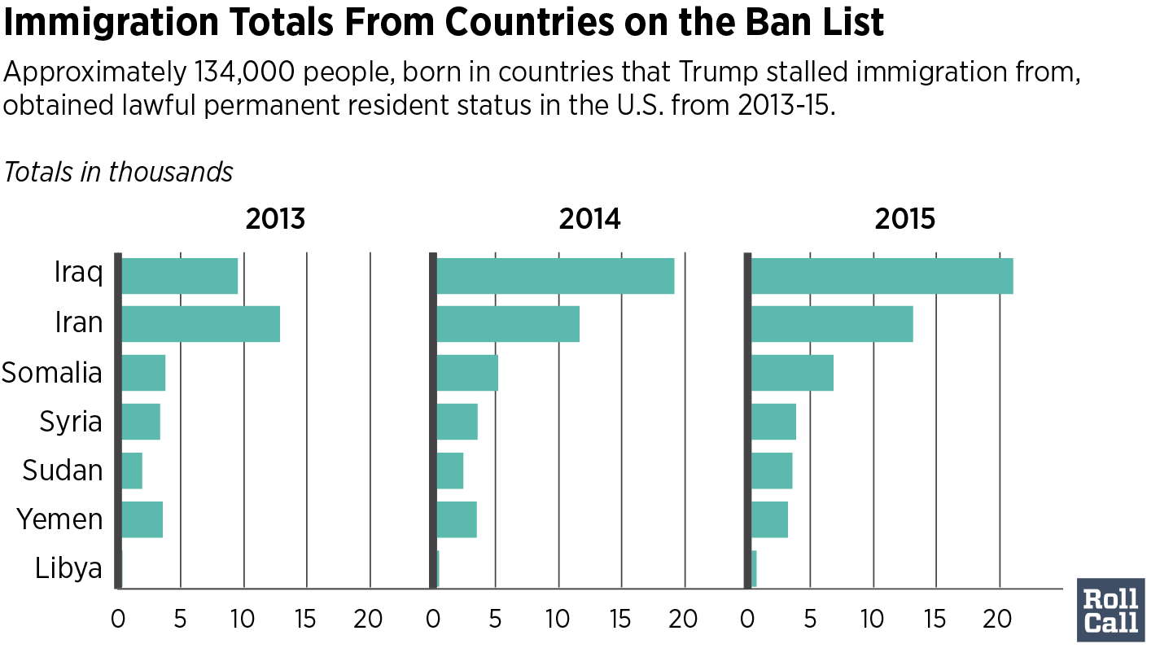
When to Use Different Charts

Slide 31
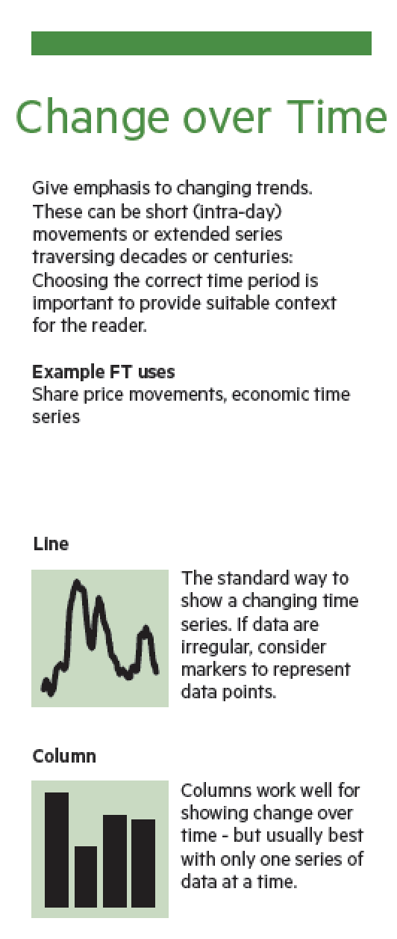
When to Use Different Charts

Slide 32
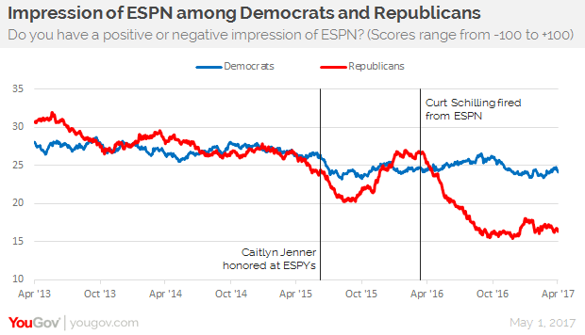
When to Use Different Charts

Slide 33
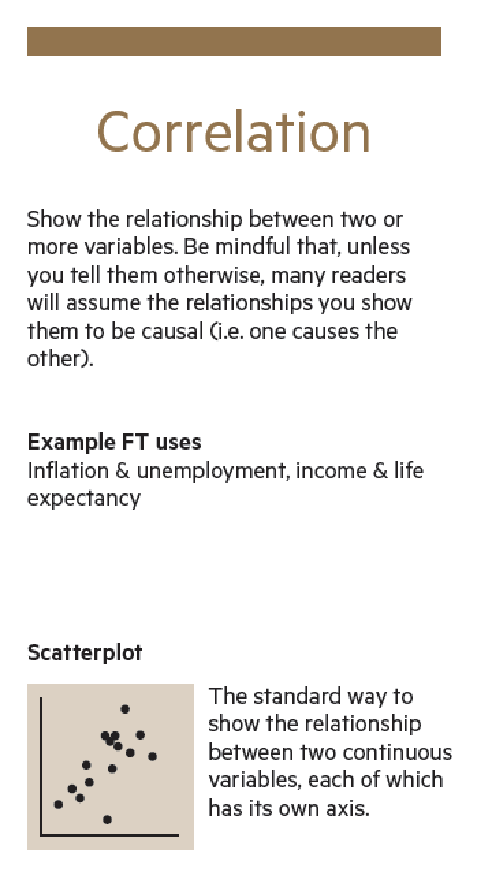
When to Use Different Charts

Slide 34
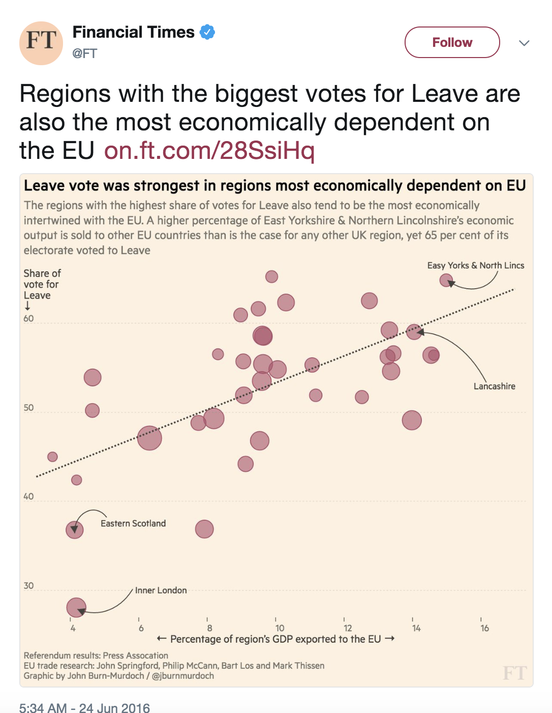
When to Use Different Charts

Slide 35
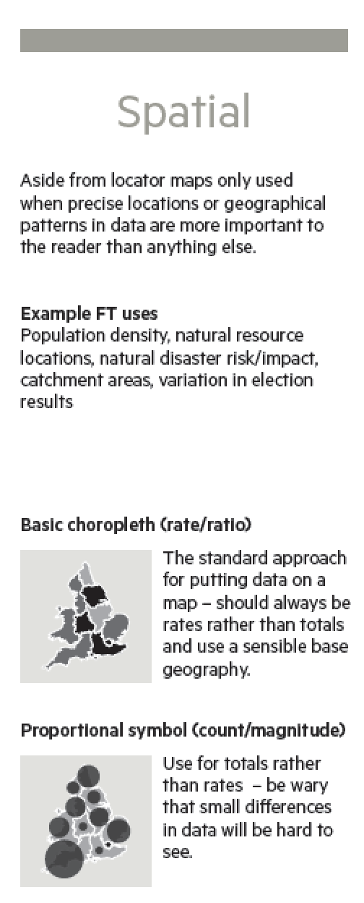
When to Use Different Charts

Slide 36
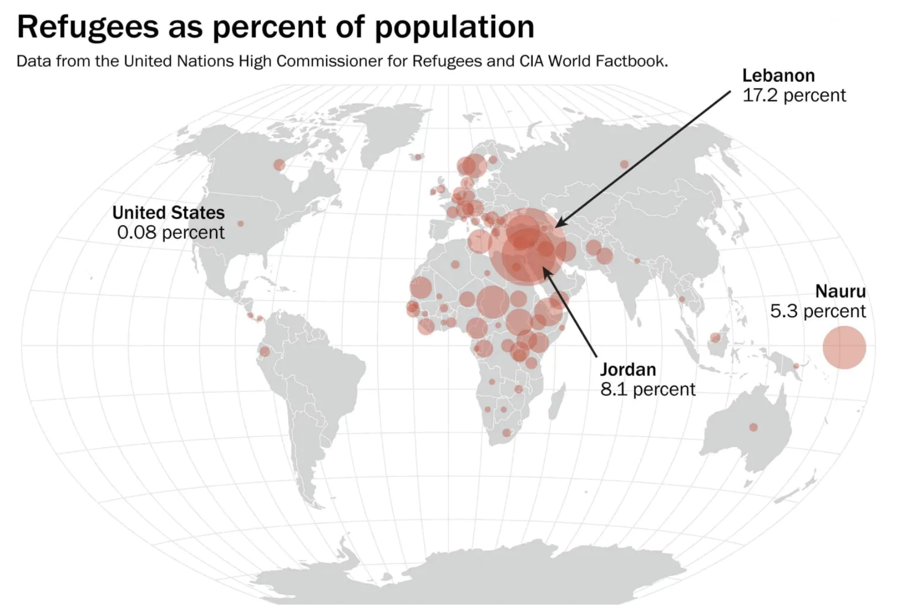
When to Use Different Charts

Slide 37
Quartz Chartbuilder
Classroom survey -> Excel -> Chartbuilder

Slide 38
Google Fusion Maps
Sports teams per state + KML shapefile for boundaries
(Note: sport team data mayyyy be sketchy http://www.city-data.com/forum/city-vs-city/1898090-states-number-sports-teams-nfl-mlb.html)

